Slide 1
Regularization
Lecture 4

Slide 2
Overview
Background
Weight Norm Regularization
Other Types of Regularization
Dropout

Slide 3
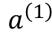
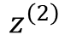
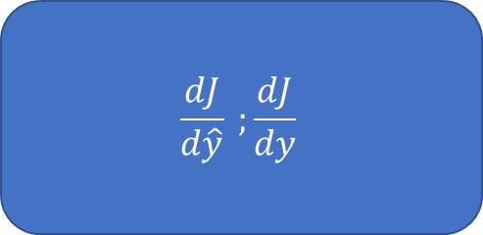
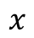



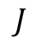

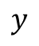
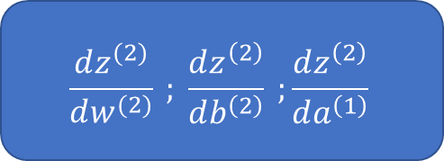
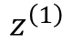
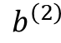
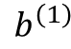

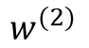

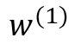

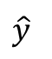
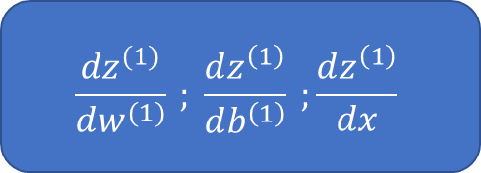
Review: Backpropogation
$$J$$
$$\frac{dJ}{d\hat{y}} ;\frac{dJ}{dy}$$
$$L_{2}$$
$$\hat{y}$$
$$y$$
$$σ$$
$$\frac{d\hat{y}}{dz^{\left(2\right)}}$$
$$z^{\left(2\right)}$$
+
$$b^{\left(2\right)}$$
$$\frac{dz^{(2)}}{dw^{(2)}} ; \frac{dz^{\left(2\right)}}{db^{\left(2\right)}} ;\frac{dz^{\left(2\right)}}{da^{\left(1\right)}}$$
$$∗$$
$$a^{\left(1\right)}$$
$$w^{(2)}$$
$$σ$$
$$\frac{da^{\left(1\right)}}{dz^{\left(1\right)}}$$
$$z^{\left(1\right)}$$
+
$$b^{\left(1\right)}$$
$$\frac{dz^{(1)}}{dw^{(1)}} ; \frac{dz^{\left(1\right)}}{db^{\left(1\right)}} ;\frac{dz^{\left(1\right)}}{dx}$$
$$∗$$
$$x$$
$$w^{(1)}$$

Slide 4
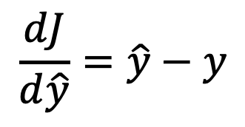
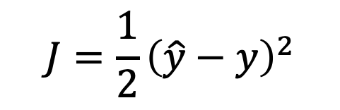
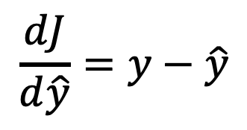
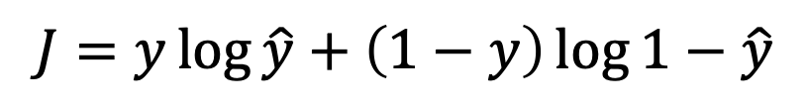
Review: Cost Function
$$J=\frac{1}{2}{\left(\hat{y}−y\right)}^{2}$$
$$\frac{dJ}{d\hat{y}}=\hat{y}−y$$
Mean Squared Error:
$$\frac{dJ}{d\hat{y}}=y−\hat{y}$$
Cross Entropy:
$$J=y\log{\hat{y}}+\left(1−y\right)\log{1−\hat{y}}$$

Slide 5
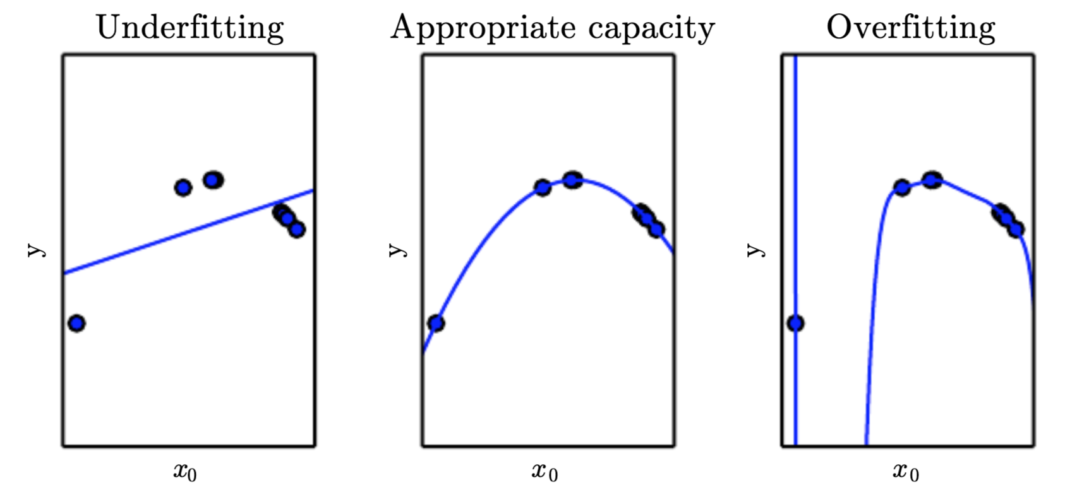
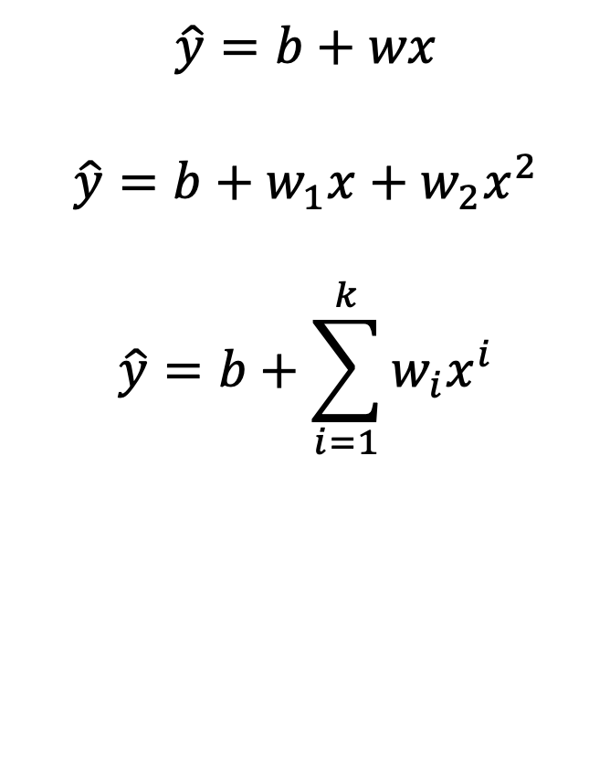
Review: Over- and Under-fitting
$$\hat{y}=b+wx$$
$$\hat{y}=b+w_{1}x+w_{2}x^{2}$$
$$\hat{y}=b+\sum_{i=1}^{k}{w_{i}x^{i}}$$

Slide 6
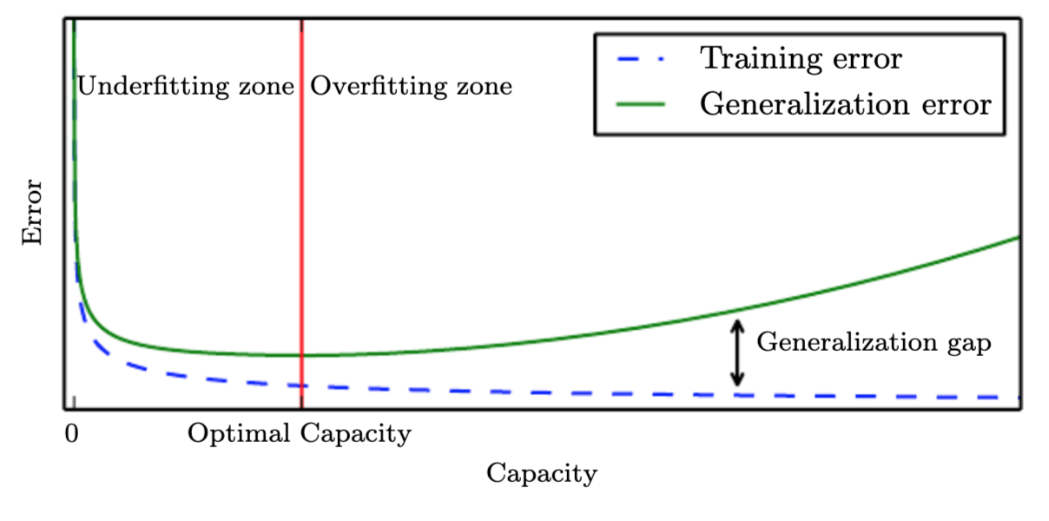
Review: Generalization Gap

Slide 7
Regularization
From the book –
“any modiﬁcation we make to a learning algorithm that is intended to reduce its generalization error but not its training error.”
Can be intended to encode specific prior knowledge
In other cases, simplify the model structure to promote generalization

Slide 8
Overview
Background
Weight Norm Regularization
Other Types of Regularization
Dropout

Slide 9
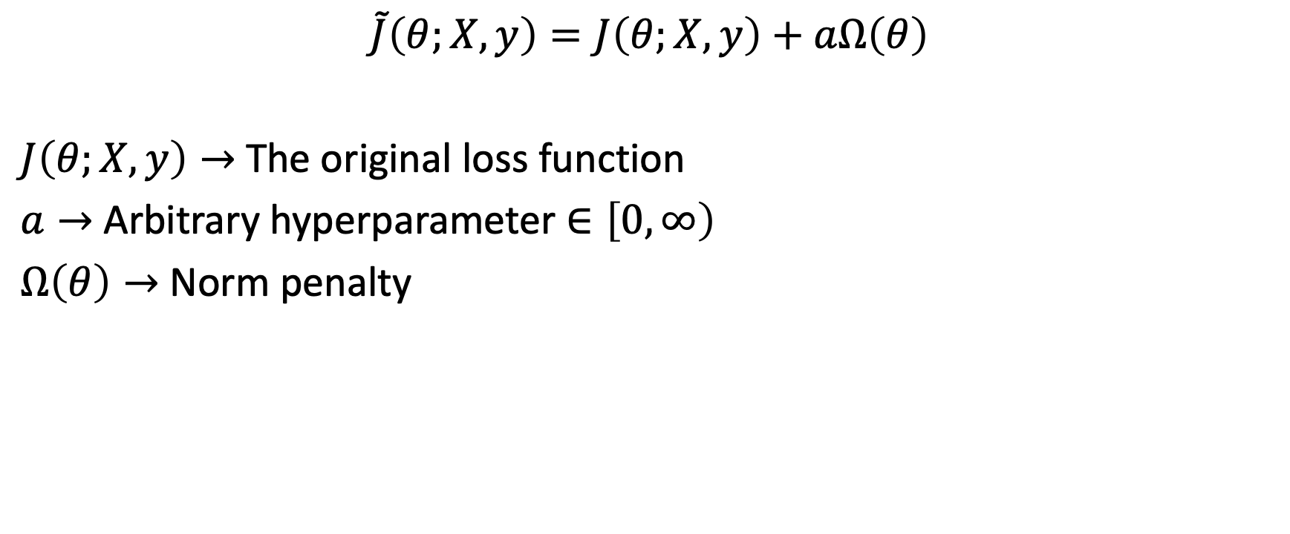
Weight Norm Based Regularization
$$\tilde{J}\left(θ;X, y\right)=J\left(θ;X, y\right)+aΩ\left(θ\right)$$
$J\left(θ;X, y\right)→$ The original loss function
$a→$ Arbitrary hyperparameter $∈\left[0, ∞\right)$
$Ω\left(θ\right)→$ Norm penalty

Slide 10
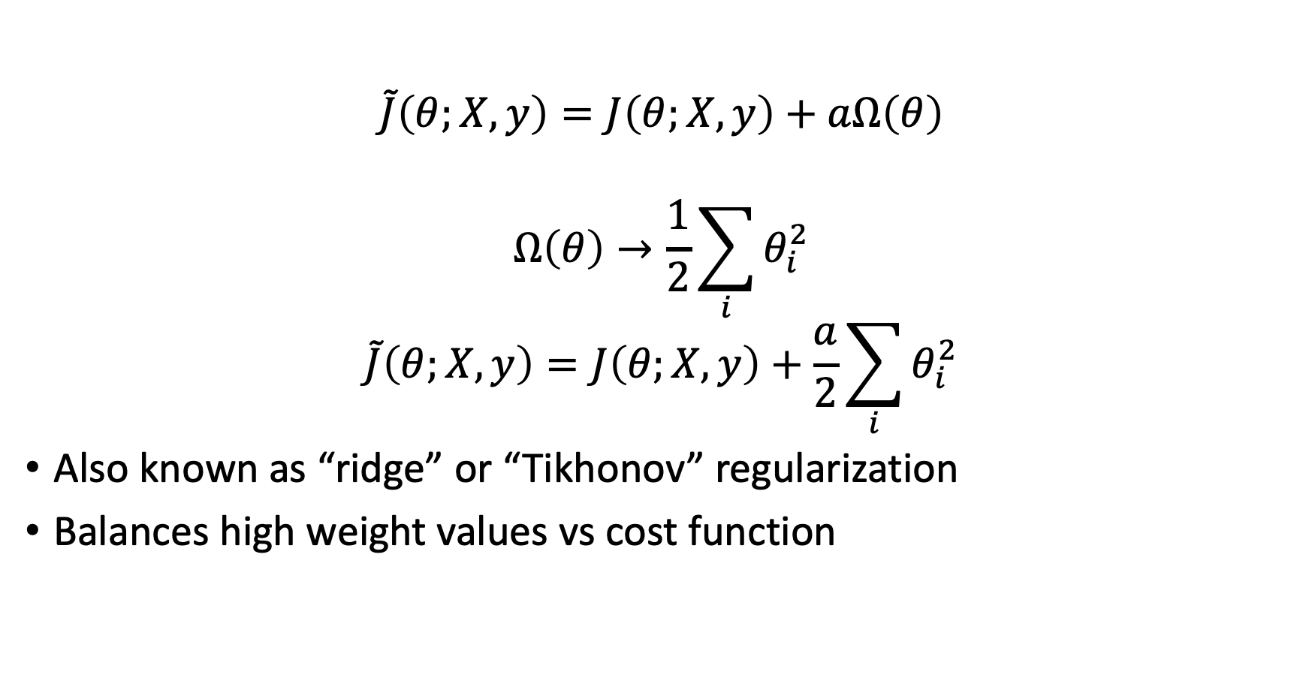
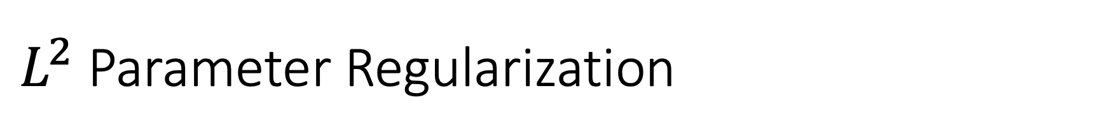
$L^{2}$ Parameter Regularization
$$\tilde{J}\left(θ;X, y\right)=J\left(θ;X, y\right)+aΩ\left(θ\right)$$
$$Ω\left(θ\right)→\frac{1}{2}\sum_{i}{θ_{i}^{2}}$$
$$\tilde{J}\left(θ;X, y\right)=J\left(θ;X, y\right)+\frac{a}{2}\sum_{i}{θ_{i}^{2}}$$
Also known as “ridge” or “Tikhonov” regularization
Balances high weight values vs cost function

Slide 11
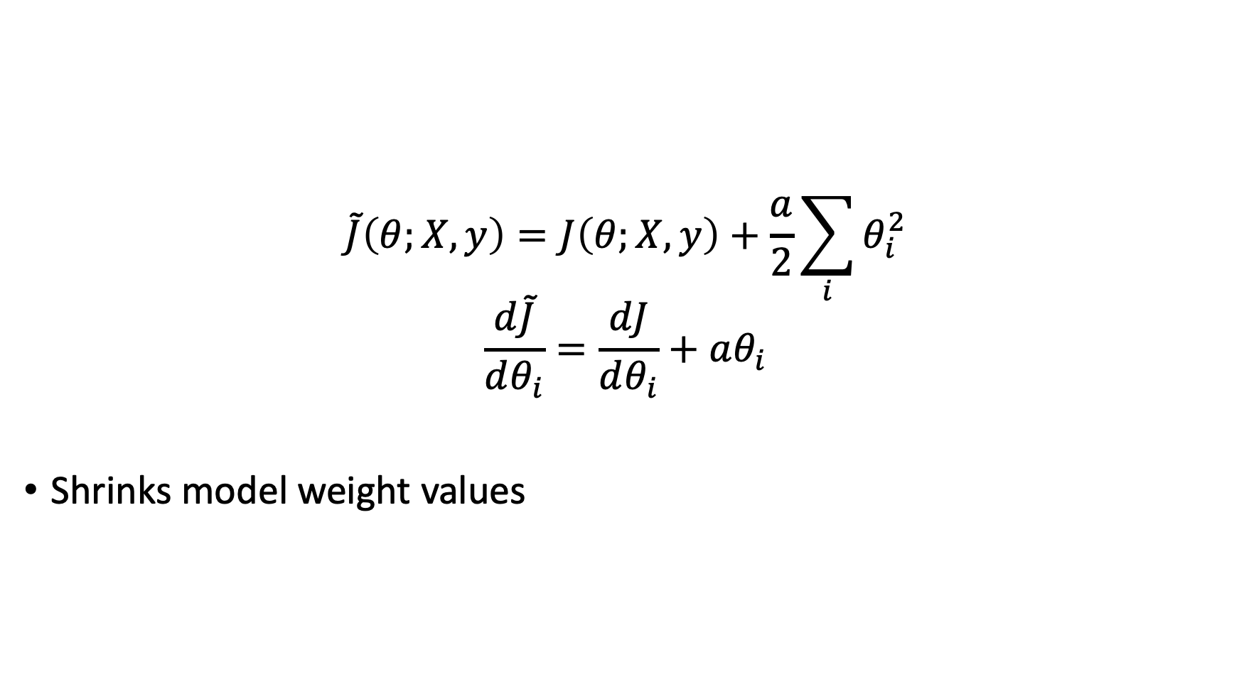
$L^{2}$ Parameter Regularization
$$\tilde{J}\left(θ;X, y\right)=J\left(θ;X, y\right)+\frac{a}{2}\sum_{i}{θ_{i}^{2}}$$
$$\frac{d\tilde{J}}{dθ_{i}}=\frac{dJ}{dθ_{i}}+aθ_{i}$$
Shrinks model weight values

Slide 12
$L^{2}$ Parameter Regularization

Slide 13
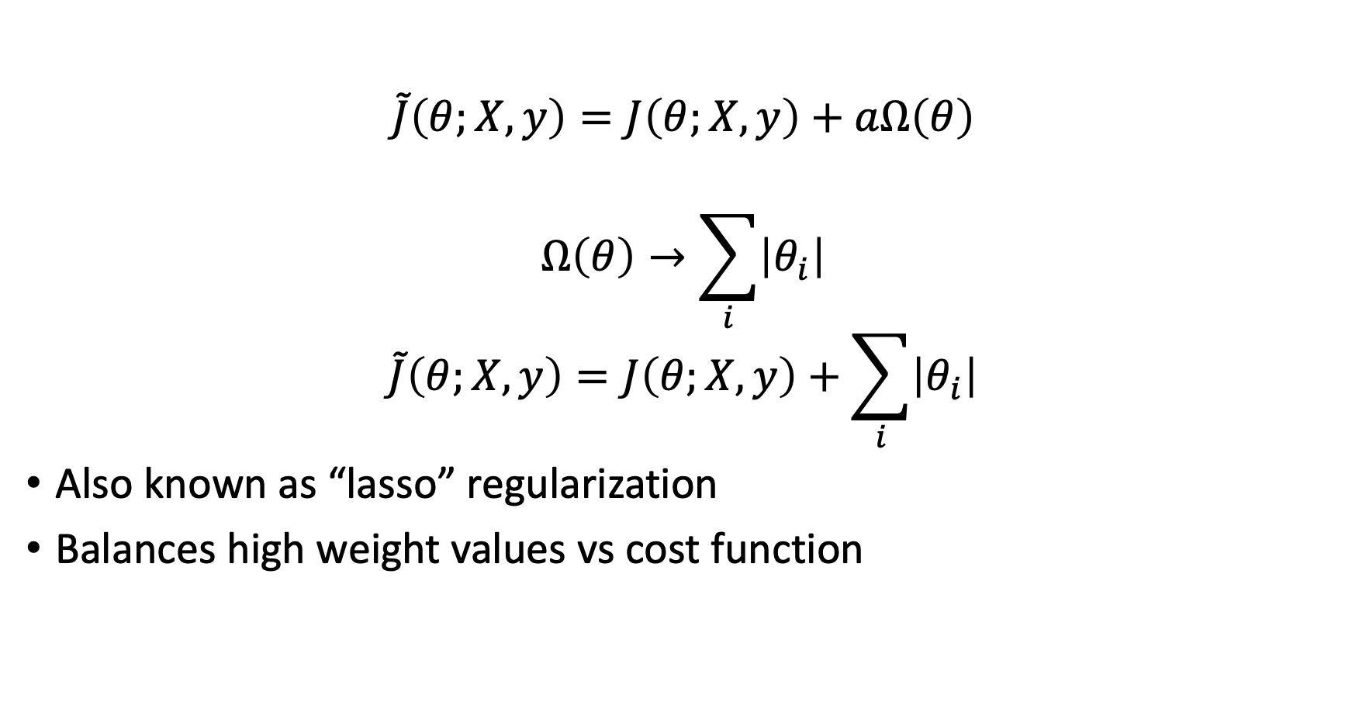
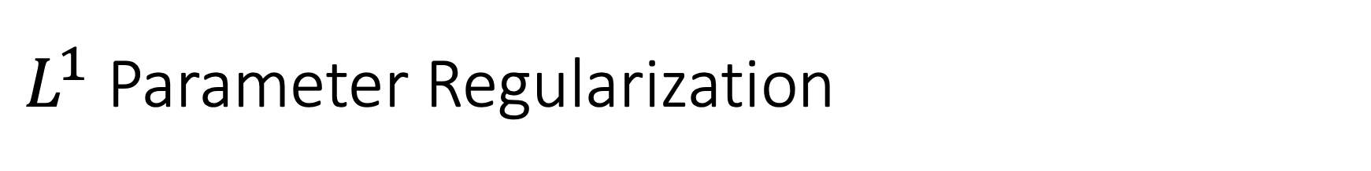
$L^{1}$ Parameter Regularization
$$\tilde{J}\left(θ;X, y\right)=J\left(θ;X, y\right)+aΩ\left(θ\right)$$
$$Ω\left(θ\right)→\sum_{i}{\left|θ_{i}\right|}$$
$$\tilde{J}\left(θ;X, y\right)=J\left(θ;X, y\right)+\sum_{i}{\left|θ_{i}\right|}$$
Also known as “lasso” regularization
Balances high weight values vs cost function

Slide 14
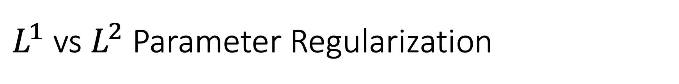
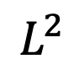
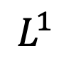
$L^{1}$ vs $L^{2}$ Parameter Regularization
$$L^{1}$$
$$L^{2}$$

Slide 15
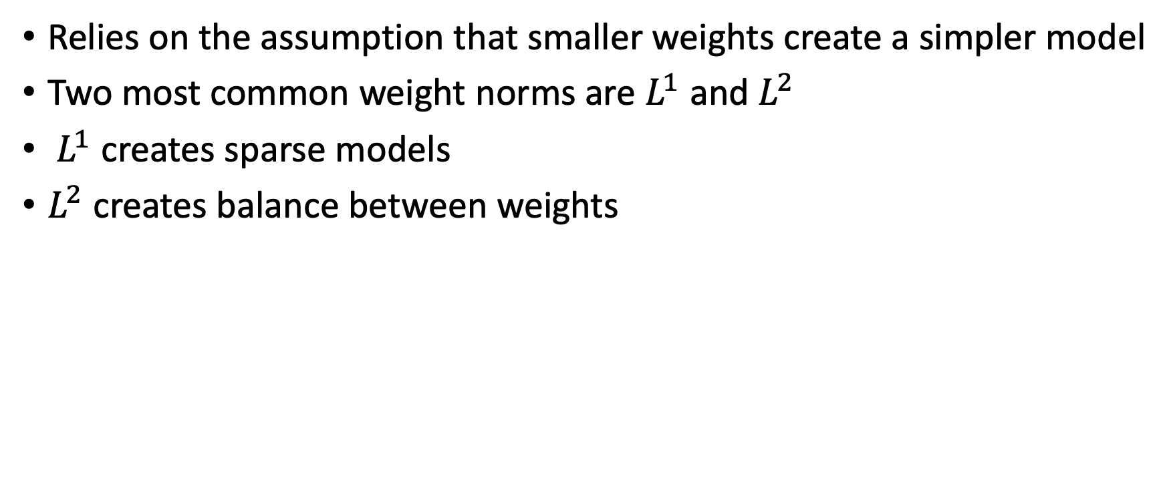
Weight norm regularization
Relies on the assumption that smaller weights create a simpler model
Two most common weight norms are $L^{1}$ and $L^{2}$
$L^{1}$ creates sparse models
$L^{2}$ creates balance between weights

Slide 16
Overview
Background
Weight Norm Regularization
Other Types of Regularization
Dropout

Slide 17
Early Stopping
Stop training the model when the generalization error stops decreasing
Typically set some threshold (i.e. 1%) and specify if generalization error does not drop by the threshold over some number of epochs, stop training the model

Slide 18
Adding Noise
Add noise, either randomly or following some meaningful distribution, to your data
Prevents model from learning patterns that are not meaningful to your results

Slide 19
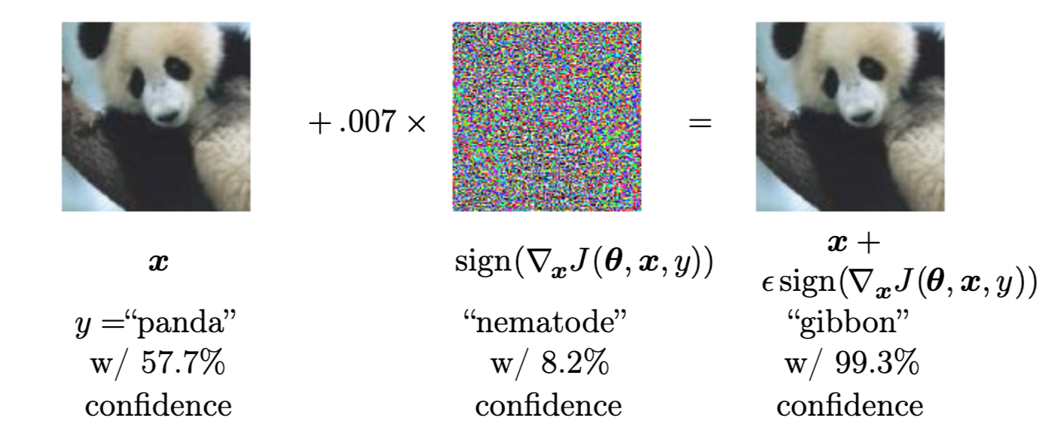
Adversarial Training
Use a neural network to create a noise pattern that optimally throws off the network you are training

Slide 20
Overview
Background
Weight Norm Regularization
Other Types of Regularization
Dropout

Slide 21
Ensemble Learning
For many problems, learning one model is good but learning multiple models is better
Models are trained with with subsets of the data, different parameter values, etc
Collection of final model is then averaged together

Slide 22
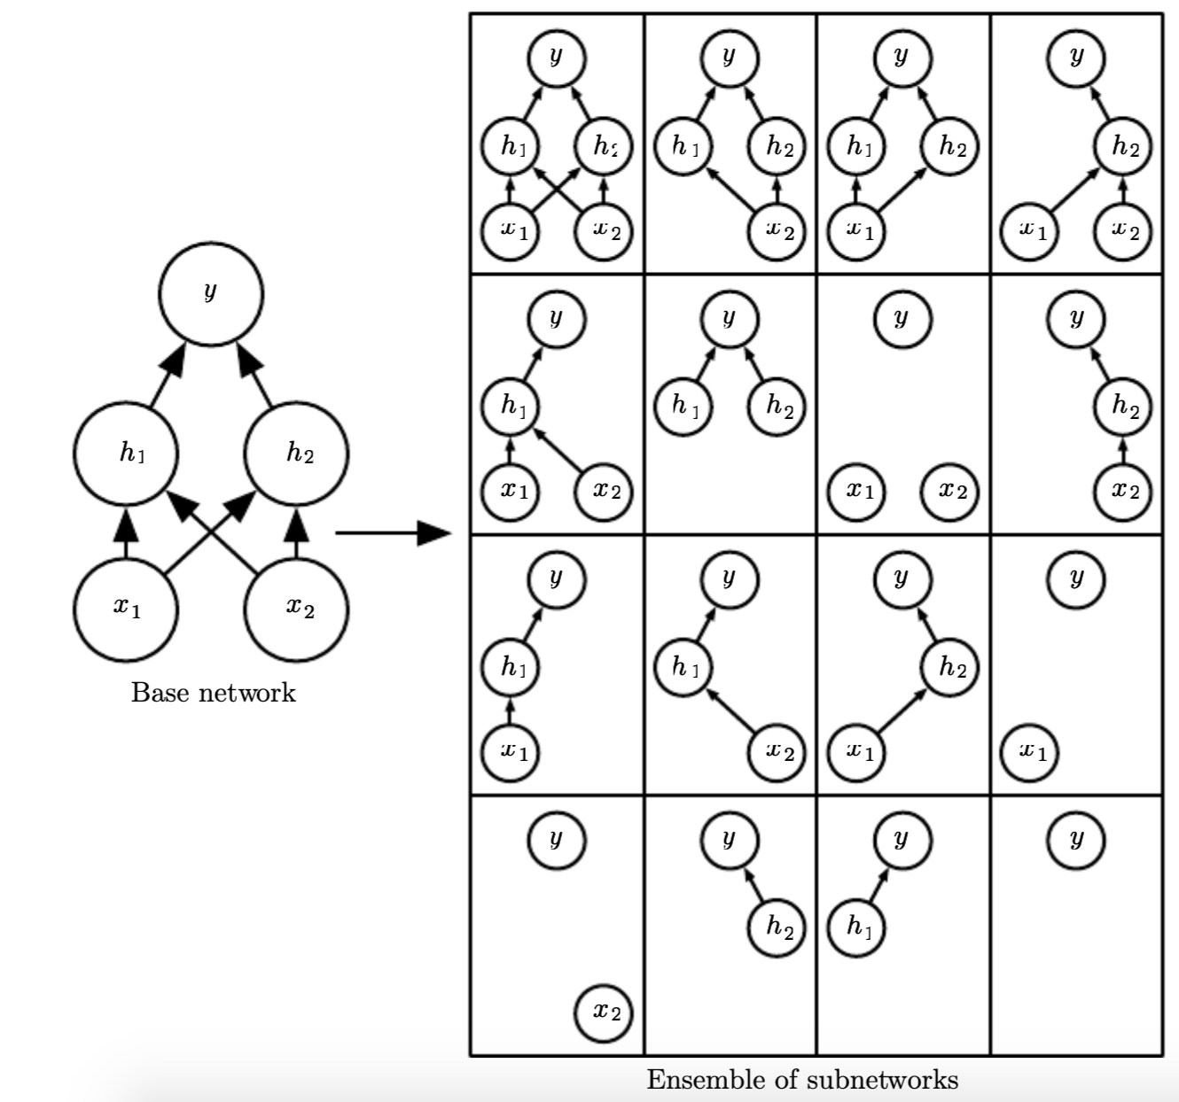
Ensemble Learning for Neural Networks
Training multiple neural networks can be very costly
We can approximate this by sampling portions of our network at a time during training
“Speciﬁcally, dropout trains the ensemble consisting of all subnetworks that can be formed by removing nonoutput units from an underlying base network”

Slide 23
Dropout Algorithm
Goal: Train all possible subnetworks of your network
During training, randomly set some portion of weight values to zero during each minibatch
Only train the weights associated that were not set to zero

Slide 24
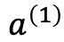
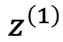
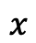

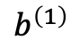
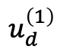


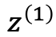
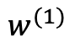
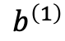
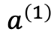
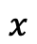
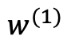


Dropout Training Computational Graph
$$a^{\left(1\right)}$$
$$σ$$
$$a^{\left(1\right)}$$
$$z^{\left(1\right)}$$
$$σ$$
+
$$b^{\left(1\right)}$$
$$z^{\left(1\right)}$$
+
$$∗$$
$$b^{\left(1\right)}$$
$$x$$
$$∗$$
$$∗$$
$$x$$
$$w^{(1)}$$
$$w^{(1)}$$
$$u_{d}^{\left(1\right)}$$

Slide 25
Dropout Inference
Lets say during training we sample 50% of the weights from hidden layers during each minibatch
When we want to make predictions, we can approximate the ensemble of all networks by using the network as one complete network
Each hidden network will then have twice the number of input weights to it than during training
As a result, we scale the weights of during inference by the dropout rate, in this case 50%

Slide 26
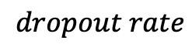
Dropout Inference Computational Graph
$$a^{\left(1\right)}$$
$$σ$$
$$a^{\left(1\right)}$$
$$z^{\left(1\right)}$$
$$σ$$
+
$$b^{\left(1\right)}$$
$$z^{\left(1\right)}$$
+
$$∗$$
$$b^{\left(1\right)}$$
$$x$$
$$∗$$
$$∗$$
$$x$$
$$w^{(1)}$$
$$w^{(1)}$$
$$dropout rate$$

Slide 27
Practical Dropout Considerations
The weight scaling rule for inference is only an approximation of the true geometric mean of all of the subnetworks
But it seems to work well
There are no guarantees for best dropout rates, methods, values, etc
Typical setup is to remove 20% of the input layer and 50% of hidden layers at random.

